Slide 1
Applying the criteria for congruence
Geometrical properties: similarity and Pythagoras' theorem

Slide 2
how to use Oak lessons

Slide 3
I can identify congruent triangles and prove why they are congruent.

Slide 4
If one shape can fit exactly on top of another using rotation, reflection or translation, then the shapes are congruent.

Slide 5

Applying the criteria for congruence
Choosing the correct criteria
Congruent or not?
Hidden congruence

Slide 6
Choosing the correct criteria
Two triangles can be proved to be congruent if certain criteria can be applied.
6.5 cm
3.6 cm
6.5 cm
4.9 cm
4.9 cm
3.6 cm
These are congruent by SSS (side-side-side).

Slide 7
Choosing the correct criteria
Two triangles can be proved to be congruent if certain criteria can be applied.
A
P
2.4 cm
5.3 cm
2.4 cm
89°
5.3 cm
89°
B
R
C
Q
These are congruent by SAS (side-angle-side).

Slide 8
Choosing the correct criteria
Two triangles can be proved to be congruent if certain criteria can be applied.
F
A
9.2 cm
99°
99°
17°
D
17°
C
E
B
9.2 cm
These are congruent by ASA (angle-side-angle).

Slide 9
Choosing the correct criteria
Two triangles can be proved to be congruent if certain criteria can be applied.
A
D
F
4.5 cm
71°
91°
91°
71°
4.5 cm
B
C
E
These are congruent by AAS (angle-angle-side).

Slide 10
Choosing the correct criteria
Two triangles can be proved to be congruent if certain criteria can be applied.
K
C
21 cm
29 cm
A
B
29 cm
I
J
21 cm
These are congruent by RHS (right angle-hypotenuse-side).

Slide 11


Choosing the correct criteria
Which of these are not a criteria for proving congruence of triangles?
a
side-angle-side (SAS)
b
angle-angle-side (AAS)
c
angle-angle-angle (AAA)
d
side-side-angle (SSA)
e
side-side-side (SSS)
f
angle-side-angle (ASA)
g
right angle-hypotenuse-side (RHS)

Slide 12
Choosing the correct criteria
C
These two triangles are congruent. Which of the criteria can we use to prove this?
4 cm
SSS
Do we know all three edge lengths?
No
A
B
5 cm
SAS
Do we know two corresponding edges and the angle between them?
No
K
ASA
Do we know two corresponding angles and one corresponding side?
5 cm
RHS
No
If it has a right angle do we know the hypotenuse and another corresponding side?
I
J
4 cm
Yes
These are congruent by RHS (right angle-hypotenuse-side).

Slide 13
Choosing the correct criteria
These two triangles are congruent. Which of the criteria can we use to prove this?
A
13°
99°
SSS
C
Do we know all three edge lengths?
No
B
4 cm
SAS
Do we know two corresponding edges and the angle between them?
No
ASA
D
Do we know two corresponding angles and one corresponding side?
4 cm
RHS
Yes
99°
F
If it has a right angle do we know the hypotenuse and another corresponding side?
E
13°
No
These are congruent by ASA (angle-side-angle).

Slide 14
Choosing the correct criteria
These two triangles are congruent. Which of the criteria can we use to prove this?
A
13 cm
SSS
Do we know all three edge lengths?
No
27°
B
C
12 cm
SAS
Do we know two corresponding edges and the angle between them?
Yes
ASA
O
13 cm
Do we know two corresponding angles and one corresponding side?
RHS
Yes
27°
M
N
If it has a right angle do we know the hypotenuse and another corresponding side?
12 cm
Yes
There is sufficient information to show these are congruent by SAS or ASA or RHS.

Slide 15
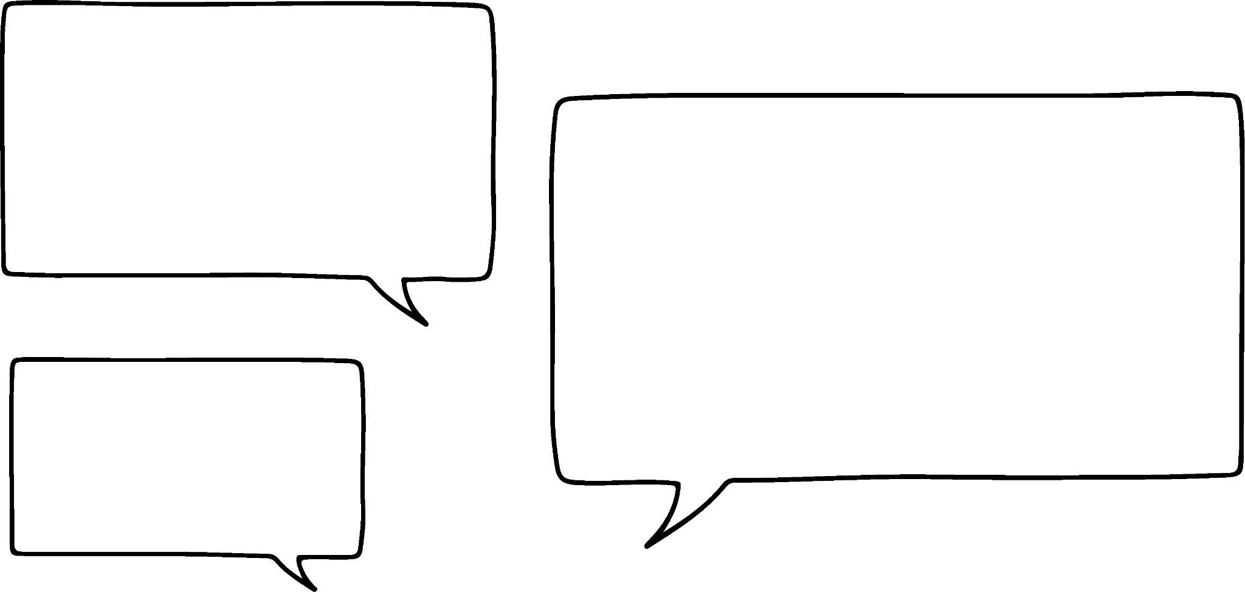
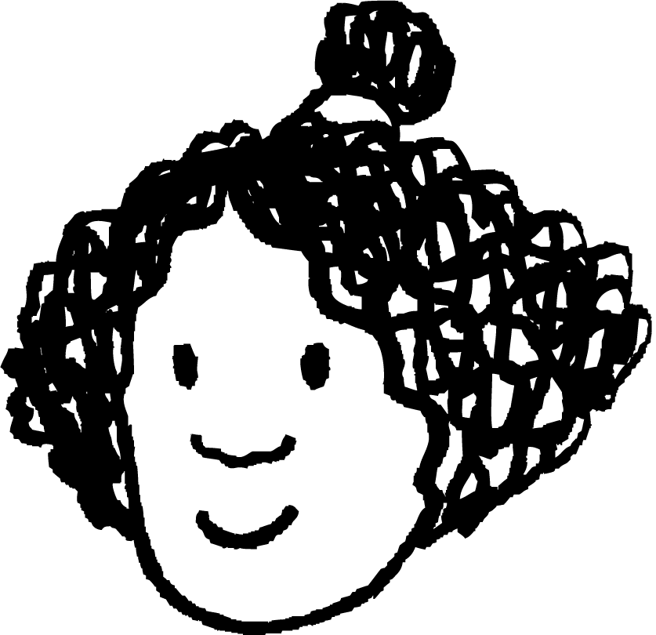
Choosing the correct criteria
These two triangles are congruent by AAS.
7.5 cm
91°
52°
52°
Is Izzy correct?
Izzy
7.5 cm
91°
No, although there are two angles and a side known on both triangles; the sides are not corresponding.

Slide 16
Choosing the correct criteria
These two triangles are congruent, but it is less obvious. Which of the criteria can we use to prove this, using only the given information?
A
39 cm
63°
27°
Do we know all three edge lengths?
No
B
C
SSS
36 cm
Do we know two corresponding edges and the angle between them?
SAS
No
O
ASA
39 cm
Do we know two corresponding angles and one corresponding side?
15 cm
No
27°
63°
RHS
M
N
If it has a right angle do we know the hypotenuse and another corresponding side?
No
From the given information, what else can we calculate?
The third angle in both triangles.

Slide 17
Choosing the correct criteria
These two triangles are congruent, but it is less obvious. Which of the criteria can we use to prove this, using all the information?
A
39 cm
63°
27°
Do we know all three edge lengths?
No
B
C
SSS
36 cm
Do we know two corresponding edges and the angle between them?
SAS
No
O
ASA
39 cm
Do we know two corresponding angles and one corresponding side?
15 cm
Yes
27°
63°
RHS
M
N
If it has a right angle do we know the hypotenuse and another corresponding side?
No
These are congruent by ASA (angle-side-angle).

Slide 18
Choosing the correct criteria
These two triangles are congruent. Which of these criteria can we use to prove it?
a
SSS
52°
b
SAS
9 cm
7.1 cm
c
AAS
52°
38°
7.1 cm
9 cm
d
RHS

Slide 19
Choosing the correct criteria
1) What criteria proves each pair to be congruent to each other?
a)
b)
10 cm
83°
26 cm
8 cm
83°
31°
26 cm
31°
8 cm
10 cm
c)
d)
7 m
61°
100°
7 m
57°
100°
3 m
62°
57°
14 cm
3 m
14 cm

Slide 20
Choosing the correct criteria
1) What criteria proves each pair to be congruent to each other?
a)
b)
10 cm
AAS or ASA
RHS
83°
26 cm
8 cm
83°
31°
26 cm
31°
8 cm
10 cm
c)
d)
7 m
AAS or ASA
61°
100°
7 m
57°
100°
3 m
62°
57°
14 cm
3 m
SAS
14 cm

Slide 21
Applying the criteria for congruence
Choosing the correct criteria
Congruent or not?
Hidden congruence

Slide 22
Congruent or not?
Are these two triangles congruent to each other?
A
X
2.4 cm
5.3 cm
2.4 cm
89°
5.3 cm
89°
B
Z
C
Y
We cannot be sure if they are congruent.
Although we have two corresponding edges, we do not know if the angle between them are equal.

Slide 23
Congruent or not?
Are these two triangles congruent to each other?
X
A
Y
40°
3 cm
3 cm
3 cm
100°
40°
B
C
Z
Yes.
We know that triangle ABC is isosceles from the given information, so the other two angles are equal and 40°.
Hence, the triangles are congruent by AAS.

Slide 24
Congruent or not?
Which of these is not congruent to the other two?
37 cm
19°
37 cm
35 cm
37 cm
12 cm
71°
71°
71°

Slide 25
Congruent or not?
1) Decide which of the triangles are congruent to triangle XYZ, giving the criteria that proves it. All edges are in centimetres.
X
7.5
a)
b)
7.5
5
91°
91°
5
52°
52°
52°
91°
Z
Y
9.1
9.1
c)
7.5
d)
e)
91°
5
37°
52°
7.5
9.1

Slide 26
Congruent or not?
2) Decide which of the triangles are congruent to triangle ABC, giving the criteria that proves it. All edges are in centimetres.
13
A
a)
b)
5
13
5
12
23°
C
B
12
f)
13
23°
d)
13
5
c)
23°
13
67°
12
13
e)
12
67°
67°
5

Slide 27

Congruent or not?
1) Decide which of the triangles are congruent to triangle XYZ, giving the criteria that proves it. All edges are in centimetres.
incongruent
X
7.5
a)
b)
7.5
ASA
5
91°
91°
5
52°
52°
52°
91°
Z
Y
9.1
9.1
c)
7.5
d)
e)
91°
5
SAS
37°
52°
SSS
7.5
not enough information
to tell
9.1

Slide 28
Congruent or not?
2) Decide which of the triangles are congruent to triangle ABC. State the criteria that proves it. All edges are in centimetres.
13
A
a)
b)
5
13
RHS
5
12
23°
C
B
12
f)
13
SSS
23°
d)
13
5
c)
23°
13
incongruent
67°
RHS
12
13
e)
ASA
12
ASA or AAS
67°
67°
5

Slide 29
Applying the criteria for congruence
Choosing the correct criteria
Congruent or not?
Hidden congruence

Slide 30
Hidden congruence
Often diagrams or shapes do not always seem to contain triangles.
A
Take this regular pentagon for example.
By drawing on some diagonals we can make triangles.
B
E
We can show that triangle ABC is congruent to triangle ADE.
C
D
AB = BC = AE = ED as they are edges on a regular pentagon
∠ABC = ∠AED as they are interior angles of a regular pentagon
Hence, triangle ABC and triangle ADE are congruent by SAS.

Slide 31


Hidden congruence
ABCD and DEFG are squares. Prove triangles CDG and ADE are congruent.
There are no triangles in this diagram.
G
F
Jun
A
Add the line segments to form them.
D
E
B
C
Sofia

Slide 32
Hidden congruence
ABCD and DEFG are squares. Prove triangles CDG and ADE are congruent.
Okay, I’m still unsure where to start though.
G
F
Jun
A
Let’s add any properties that we know.
D
E
B
C
Sofia

Slide 33
Hidden congruence
I can see that both triangles have two edges of the same length.
ABCD and DEFG are squares. Prove triangles CDG and ADE are congruent.
G
F
Jun
A
Plus, the angle between them is the same.
D
E
B
C
Sofia

Slide 34
Hidden congruence
ABCD and DEFG are squares. Prove triangles CDG and ADE are congruent.
What ∠CDG and ∠ADE?
G
F
Jun
A
Yes, they are both 90° plus ∠ADG.
D
E
B
C
Sofia

Slide 35
Hidden congruence
ABCD and DEFG are squares. Prove triangles CDG and ADE are congruent.
So they are congruent by SAS!
G
F
Jun
A
D
E
Yes!
B
C
Sofia

Slide 36
Hidden congruence
Triangle CDG is congruent to triangle ADE by SAS.
G
F
What angle corresponds to ∠DAE?
∠GCD
(∠DCG)
A
D
E
B
C

Slide 37
Hidden congruence
Given that PQRS is a parallelogram and PT = RU. Prove that TQ = SU.
P
T
S
If we can show that triangle PTQ and triangle SUR are congruent, then this implies corresponding edges are the same length and hence TQ = SU.
Q
U
R
TP = RU given
PQ = SR as they are opposite sides of a parallelogram
∠TPQ = ∠SRU as they are opposite angles of a parallelogram
Triangle PTQ is congruent to triangle SUR by SAS, therefore TQ = SU

Slide 38
Hidden congruence
Complete the statements.
From this diagram, triangle AEB and triangle AGD can be proved to be congruent by .
Therefore, and
B
C
SAS
F
BE =
GD
E
G
AGD
∠AEB = ∠
A
D

Slide 39
Hidden congruence
1) ABCDEFGH is a regular octagon.
a) Prove triangles ABC and triangle HGF are congruent.
b) What other triangles are congruent to ABC?
A
H
B
G
C
F
D
E

Slide 40
Hidden congruence
2) ABDF is a square. BCD and DEF are equilateral triangles. Prove triangles CDE and FDC are congruent.
A
F
E
B
D
C

Slide 41
Hidden congruence
1) ABCDEFGH is a regular octagon.
a) Prove triangles ABC and triangle HGF are congruent.
b) What other triangles are congruent to ABC?
A
H
AB = BC = HG = GF as the octagon is regular
∠ABC = ∠HGF as they are interior angles of the regular octagon
Triangle ABC is congruent to triangle HGF by SAS.
B
G
C
F
D
E
Triangles BCD, CDE, DEF, EFG, GHA and HAB are congruent to ABC

Slide 42
Hidden congruence
2) ABDF is a square. BCD and DEF are equilateral triangles. Prove triangles CDE and FDC are congruent.
CD is a common edge to both triangles
DF = DE as they are edges of the same equilateral triangle
∠CDF = 90 + 60 = 150°
∠CDE = 360 - (60 + 90 + 60) = 150°
Therefore, ∠CDF = ∠CDE
A
F
E
60°
B
D
C
So, triangle CDE is congruent to triangle FDC by SAS.

Slide 43
Applying the criteria for congruence
If one of the criteria (SSS, SAS, ASA, RHS) apply, then the two triangles are congruent.
In some cases more than one criteria can be used to prove congruence.
If two triangles are proven to be congruent, then you can also prove equal lengths.

Slide 44

© Oak National Academy 2024.
Produced in partnership with Mathematics in Education and Industry.
Licensed on the Open Government Licence v3.0, except where otherwise stated. See Oak terms and conditions.

